Slide 1


NVME Over Fabrics Senior Design Project May 25, 2016
ERIC LITVINSKY
JAYDEN NAVARRO
ALICE YU
TEAM MEMBERS:
JOHN GEMIGNANI
COY HUMPHREY

Slide 2
Problem Statement
The purpose of this project is to assemble and benchmark an RDMA based network protocol stack for implementing NVMe over fabrics. The protocol stack is designed to provide high throughput transfers, with low CPU utilization. This is needed to test the viability of porting the protocol stack to HP Enterprise’s 3Par Storage Systems with NVMe (Non-Volatile Memory Express) attached storage devices.

Slide 3
Project Goals
Assemble protocol stack
Determine appropriate protocols to use
Install protocols on server
Benchmark protocol stack
Determine metrics to benchmark
Assemble benchmarking suite
Gather results in a parseable format
Determine Viability
Analyze benchmarks

Slide 4
Our Approach
Research the technologies involved in our project
Accelio, RoCE V2, nbdX, Mellanox OFED Drivers
Put together an action plan using Agile methodologies to
Assemble the RDMA protocol stack on our servers
Install benchmarking software (fio)
Create Python Benchmarking Framework
Create a C program to test the nbdX device
Fix stability issues in nbdX
Fixed crashes that occurred during nbdx startup and teardown
Gather and analyze benchmarking results

Slide 5
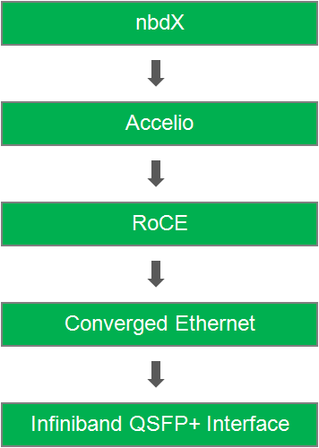
1
Protocol Stack
■ Network block device over Accelio framework
■ Presented as a regular storage block device on the local system
■ Pre-specification version of NVMe over Fabrics
■ Library for high-performance asynchronous IO using RDMA
■ Provides Zero-copy data delivery
■ Designed for multi-core CPUs and multi-threaded applications
■ Remote Direct Memory Access (RDMA) is capable of allowing server to server data movement management with minimal CPU involvement
■ Provides a lossless connection on top of the Ethernet protocol by implementing the Data center bridging enhancements (DCB) to the Ethernet standard.
■ Bridges, converges, and controls the flow of multiple classes of traffic over an Ethernet network
■ Hardware support for RDMA
■ Interconnect system for the I/O ports that supports 40Gb Ethernet

Slide 6
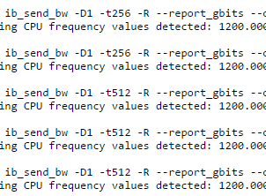
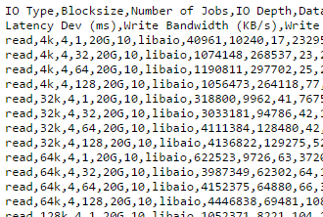
Benchmarking Suite
Python automated framework
Python FIO and ib_send_bw scripts
‘Run_All’ Bash scripts with error report handling
Results parsed and outputted to CSV format
Run_All Script
2
FIO
ib_send_bw
Error Log
Framework
Git
CSV Data

Slide 7
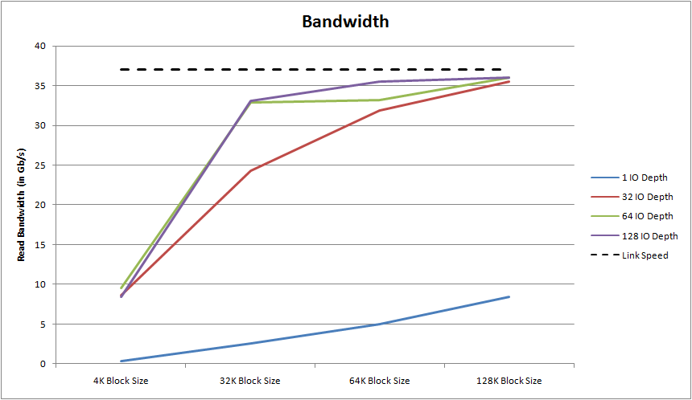
Results
Graph 1: nbdX was able to yield > 250,000 4K IOPS on 32, 64, and 128 IO depths. Compared to the ~100,000 4K IOPS of NVMe attached drives, the network will not be the IOPS bottleneck for remote transfers.

Slide 8
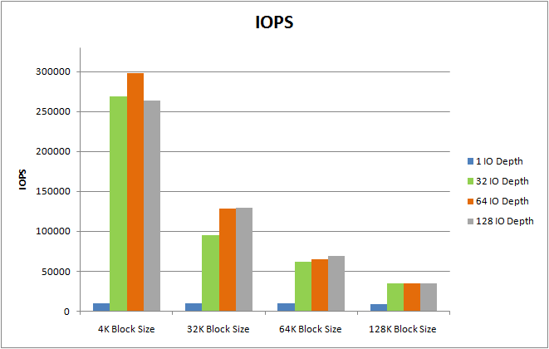
Results
Graph 2: On large block sizes, nbdX performed close to our maximum link speed (37 Gb/s). Compared to the ~8.0 Gb/s transfer speeds of NVMe attached drives, the network will not be the throughput bottleneck for remote transfers.

Slide 9
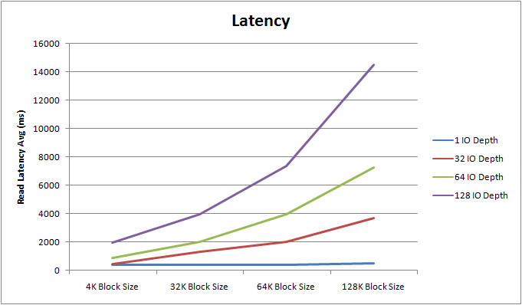
Results
Graph 3: Latency was higher than we were expecting. If we continued on with this project, this would be a primary point of investigation.

Slide 10
Thanks to
Samuel Fineberg, Ph.D., Distinguished Technologist, Storage Chief Technologist Office at Hewlett Packard Enterprise
Dr. Linda Werner, Ph.D., Faculty Advisor, UCSC
Daniel Fava, Graduate Teaching Assistant, UCSC
Kevin Cheng for participating in the first half of the project
HPE for the hardware and support provided

